Slide 1
Cell Structure and Function
Week 3 - Laboratory 5

Slide 2
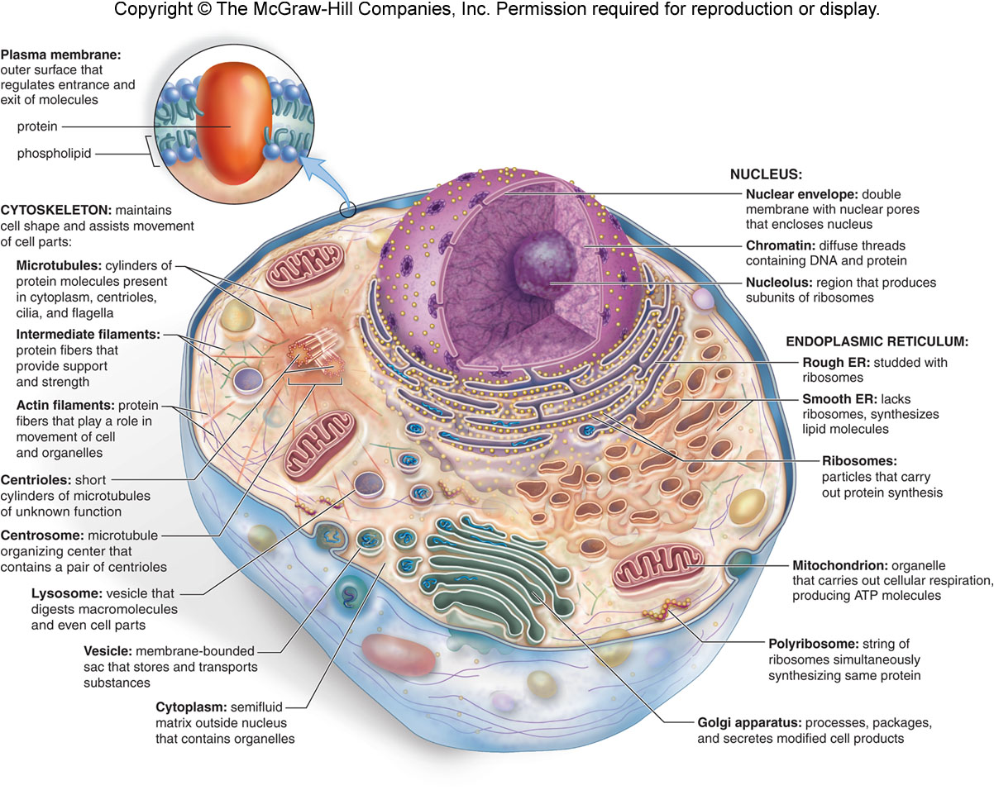
Fig. 3.4a
3.2 How Cells are Organized

Slide 3
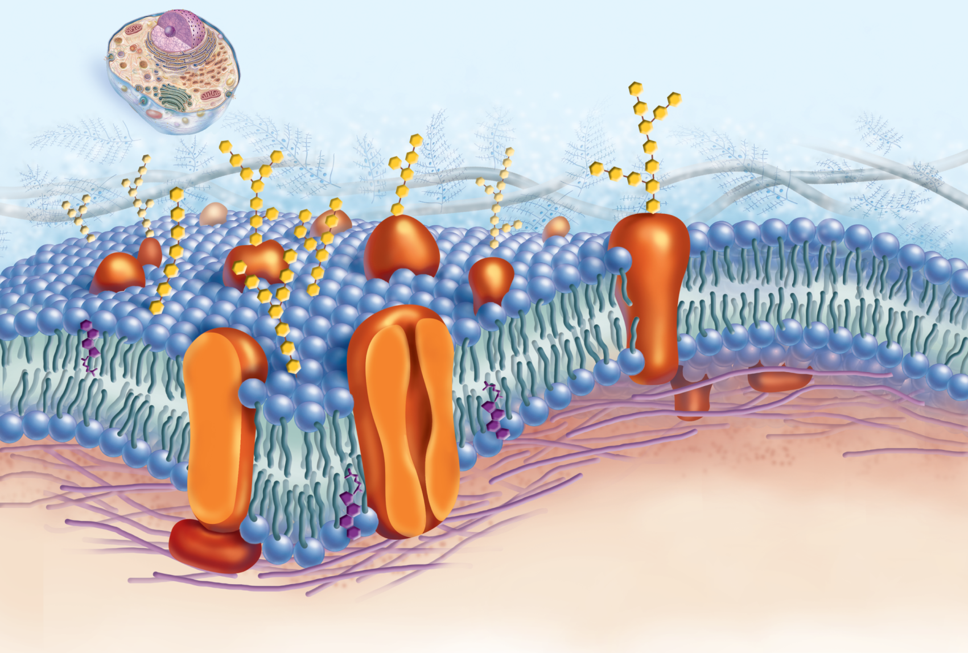
3.3 The Plasma Membrane and How Substances Cross It
https://www.youtube.com/watch?v=_3lNYbt0eAs
plasma membrane
Outside
carbohydrate
chain
extracellular
matrix (ECM)
hydrophobic
tails
hydrophilic
heads
glycoprotein
glycolipid
phospholipid
bilayer
filaments of cytoskeleton
Inside
peripheral protein
integral protein
cholesterol
cholesterol
Figure 3.6 Organization of the plasma membrane.
Notes:
It is a phospholipid bilayer.
It is embedded with proteins that move in space.
It contains cholesterol for support.
It contains carbohydrates on proteins and lipids.
It is selectively permeable.

Slide 4
Passage of Molecules Across a Plasma Membrane
3.3 The Plasma Membrane and How Substances Cross It
I. Passive Transport — a cell exerts no energy in gaining materials from its environment. “With the Conc. Gradient”
Types of Passive Transport:
Diffusion—random movement of molecules from the area of higher concentration to the area of lower concentration.
Osmosis*—diffusion of H₂O across a plasma membrane.
Hypotonic solutions—cause cells to swell & burst due to an intake of H₂O.
Hypertonic solutions—cause a cell to shrink due to loss of H₂O.
Isotonic solutions- solution—equal amounts of solute and solvent. (there is no net gain or loss of H₂O)
Facilitated transport*—some molecules are transported by means of protein carriers within the membrane.
II. Active Transport — a cell must use ATP to transport substances through the plasma membrane. “Against the Concentration Gradient” Endocytosis and Exocytosis

Slide 5
Diffusion of Solutes
Random movement of molecules from an area of higher concentration to the area of lower concentration until they are equally distributed
Influencing factors
Temperature
Resistance of medium
Experiment: Diffusion of semisolid compared to liquid

Slide 6
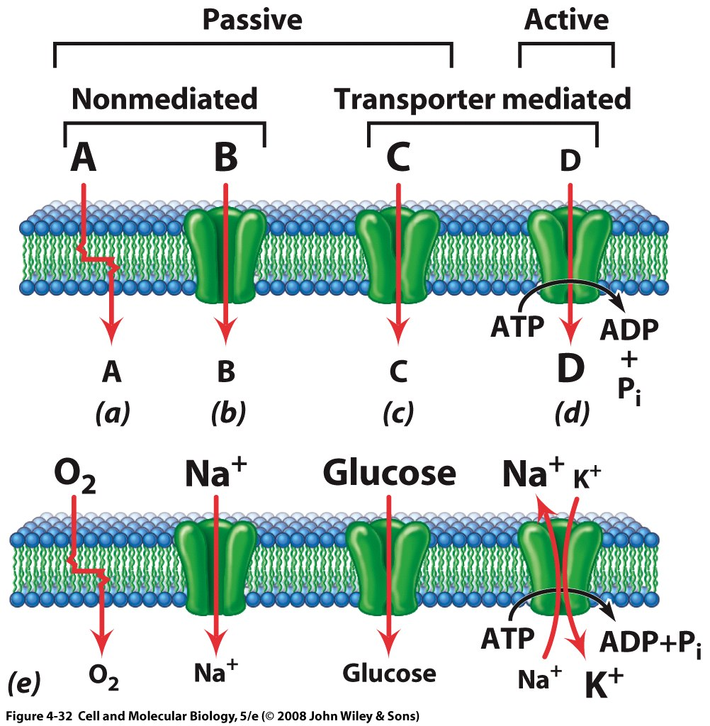
The Plasma Membrane and Diffusion of Solutes
Plasma membrane
Regulates the passage of molecules into and out of cells
Selectively permeable
Only small, non-charged molecules can diffuse across the plasma membrane without assistance
Experiment – set up a representative cell in a solution and observe how the contents diffuse

Slide 7
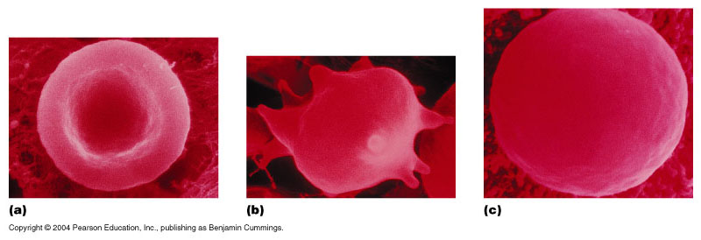
Osmosis
Facilitated transport of water occurs through a channel protein, aquaporin
Tonicity – relative concentration of solute and solvent outside the cell compared to inside the cell
Isotonic solution
Hypertonic solution
Hypotonic solution
Red blood cells
0.9% NaCl is isotonic to red blood cells
Hypertonic solutions cause crenation in red blood cells
Hypotonic solutions cause hemolysis in red blood cells
Image from Highlands.edu

Slide 8
Human Biology Tie to Studies related to Tonicity
Dehydration
Blood becomes hypertonic to cells and, in response, the cells lose water
Water intoxication
Blood becomes hypotonic to cells
Can lead to pulmonary edema (the lungs gain water) and swelling in the brain
In extreme cases, it is fatal
Can be due to too much pure water during vigorous exercise
Cure is to intravenously introduce high amounts of sodium

Slide 9
3.6 Mitochondria and Cellular Metabolism
Enzymes are crucial for many activities in the cell.
Most enzymes are proteins.
Enzymes are often named for the molecules that they work on, called substrates.
Enzymes are specific to what substrate they work on.
Enzymes have active sites where a substrate binds.
Enzymes are not used up in a reaction but instead are recycled.
Some enzymes are aided by nonprotein molecules called coenzymes.

Slide 10
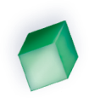
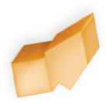
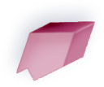

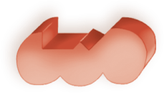
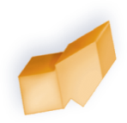

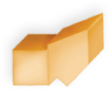
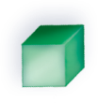
3.6 Mitochondria and Cellular Metabolism
How do enzymes work*?
Copyright © The McGraw-Hill Companies, Inc. Permission required for reproduction or display.
products
product
enzyme
enzyme
substrate
substrates
enzyme–substrate
complex
enzyme–substrate
complex
active site
active site
Degradation
A substrate is broken
down to smaller products.
Synthesis
Substrates are combined
to produce a larger product.
enzyme
enzyme
Figure 3.18 Action of an enzyme.

Slide 11
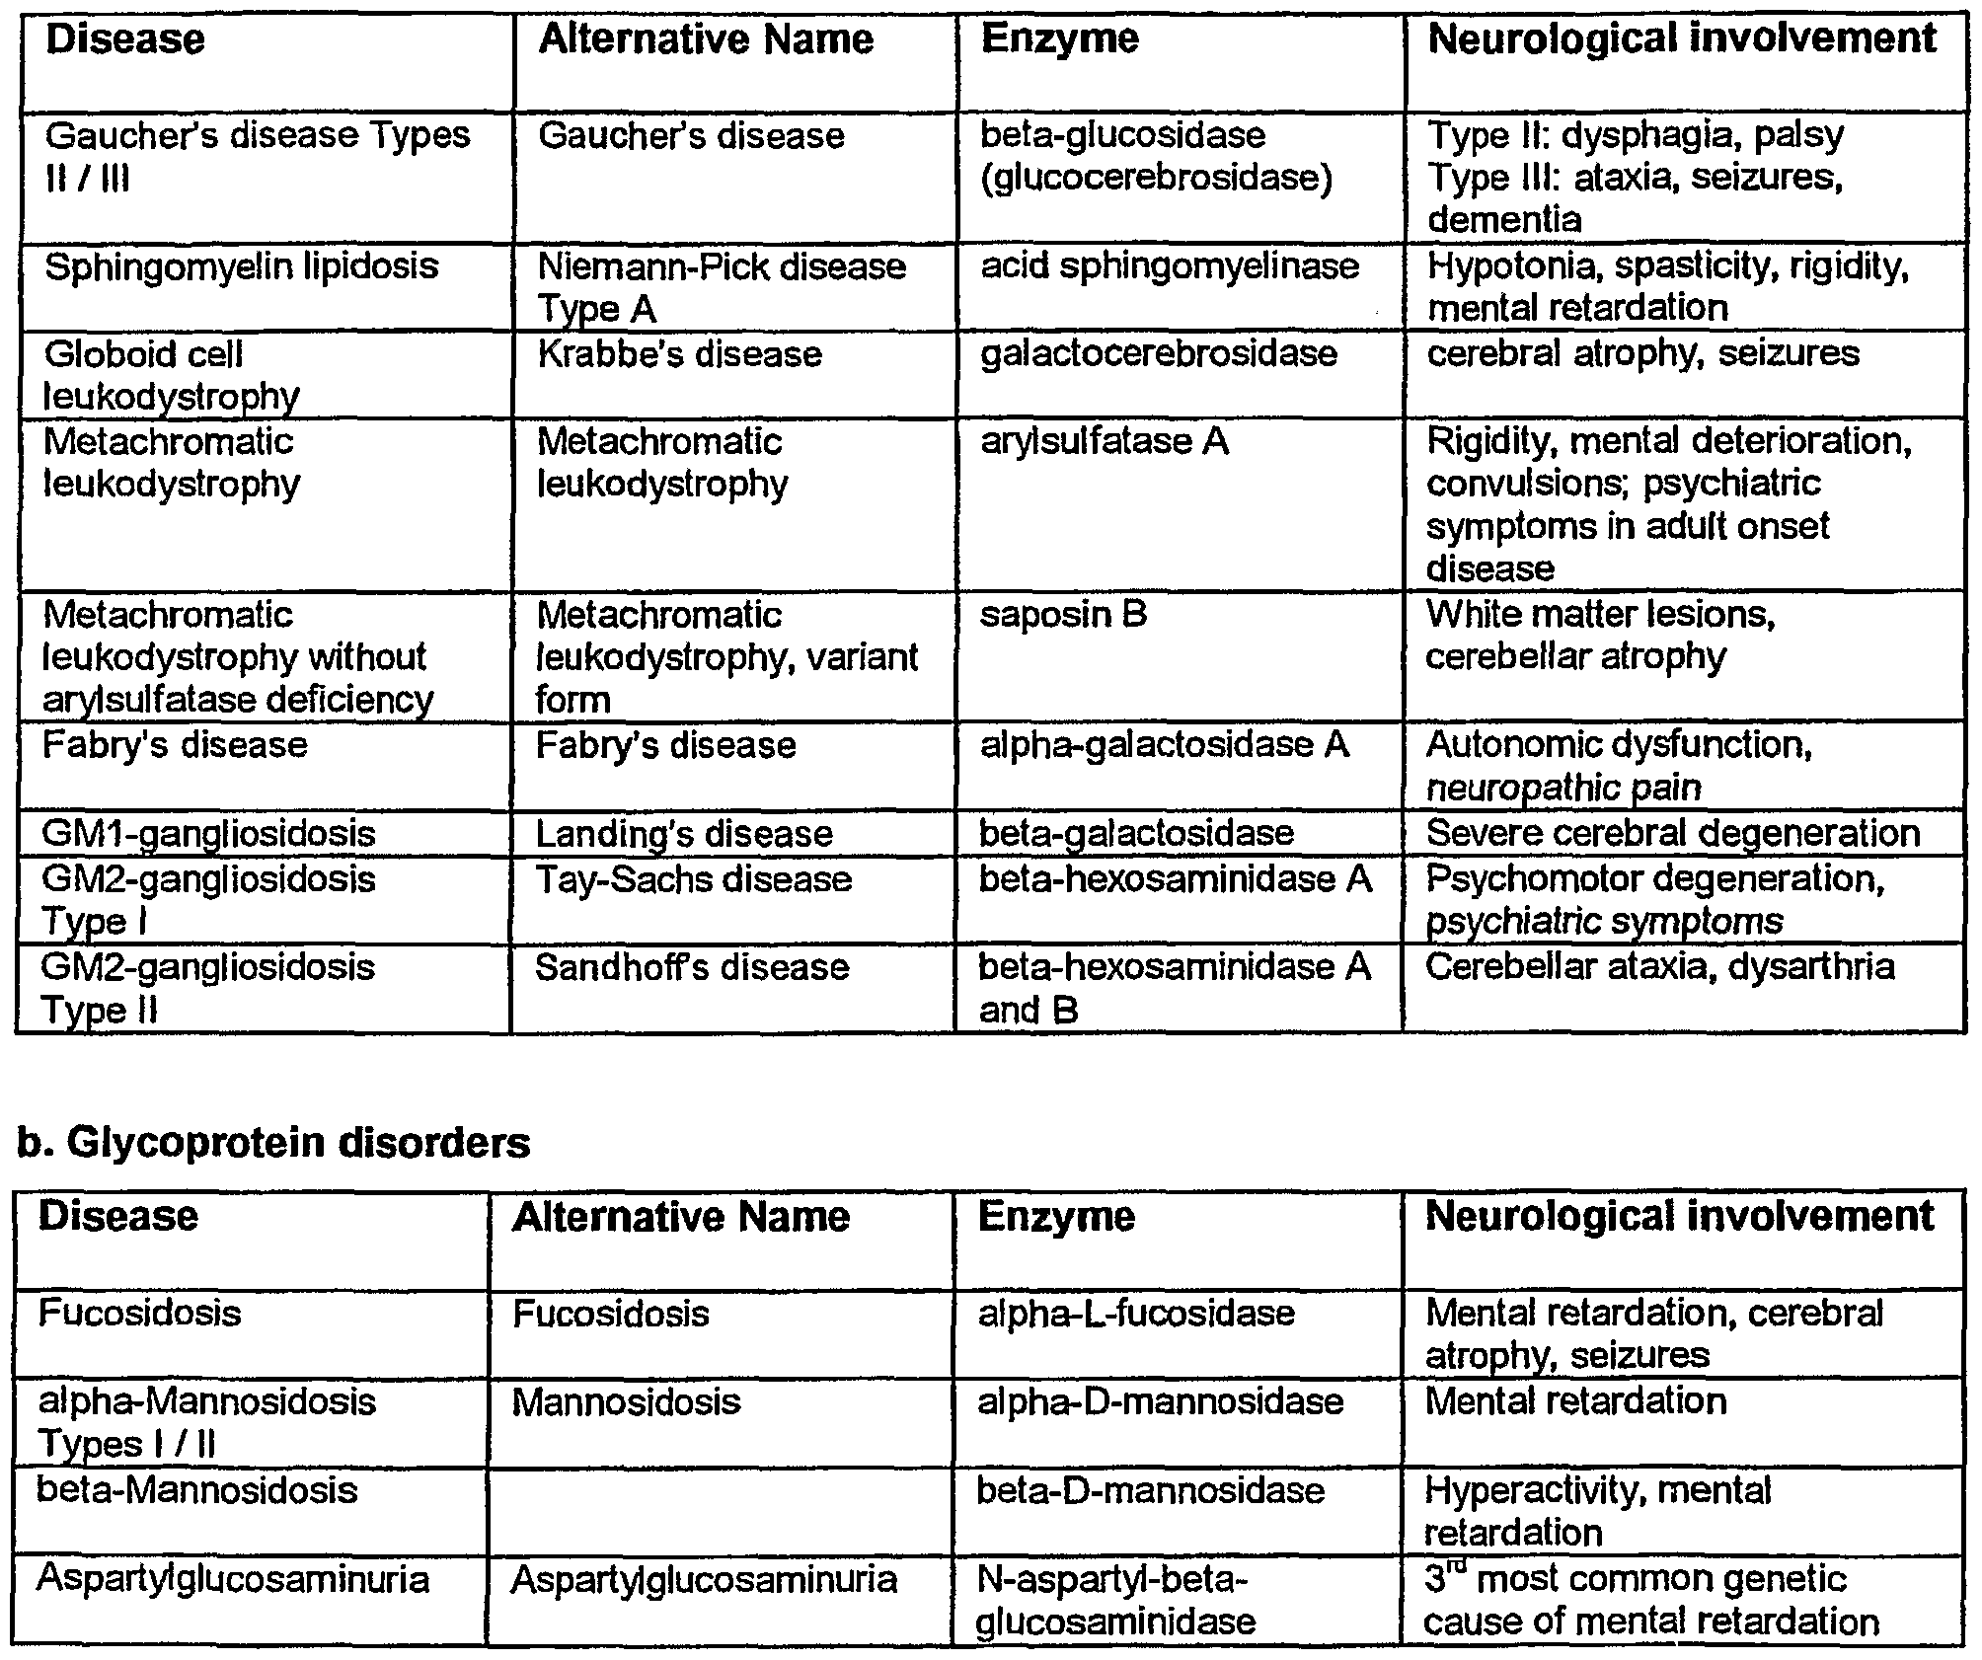
Roles of enzymes in neurological disease

